Slide 1
Polymorphism, Virtual functions & Abstract Classes

Slide 2
Polymorphism
The word polymorphism means having multiple forms.
The term Polymorphism gets derived from the Greek word where poly + morphos where poly means many and morphos means forms.
Polymorphism in programming means: a function the same as another in name but with different behavior.
Polymorphism
Compile time
Run time
Function Overloading
Function Overriding
Virtual Functions

Slide 3
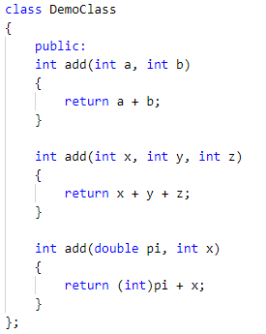
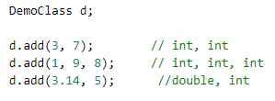
Polymorphism
Compile time Polymorphism

Slide 4
Polymorphism (contd..)
You can pass an object of a derived class to a formal parameter of the base class type

Slide 6
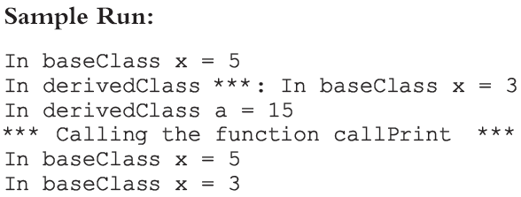
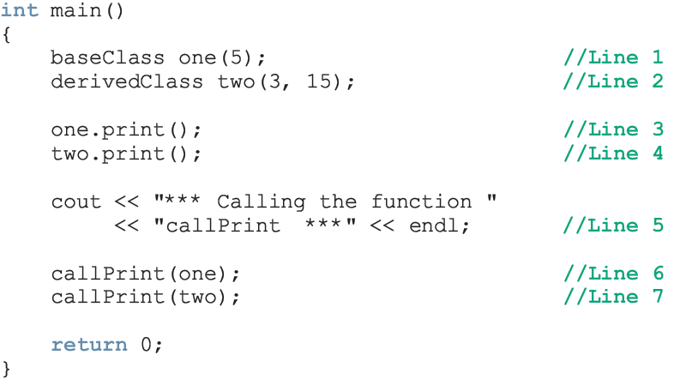

Slide 7
Polymorphism (contd..)
For both statements (Lines 6 and 7), member function print of baseClass was executed
Because the binding of print, in the body of callPrint, occurred at compile time
Compile-time binding: the necessary code to call a specific function is generated by the compiler
Also known as static binding or early binding

Slide 8
Virtual Functions
How can we avoid this problem?
Virtual functions (reserved word virtual)
Virtual function: binding occurs at program execution time, not at compile time
This kind of binding is called run-time binding
Run-time binding: compiler does not generate code to call a specific function; it generates information to enable run-time system to generate specific code for the function call
Also known as dynamic binding

Slide 9
Virtual Functions (contd…)

Slide 10
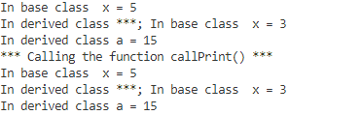
Sample Run

